Slide 1
Online Job Portal
Using MVC.Net framework

Slide 2
Team Structure
2018-CS-114 Minahil Tayyab
2018-CS-131 Ayesha Azam
2018-CS-132 Sofia Hassan

Slide 3
Overview

Slide 4
Objectives
It provides the job seekers with jobs information.
It provide a platform of online applying for jobs.
It is time saving
And also money saving
It provides a secure and comfortable environment for user experience

Slide 5
Targeted Users
Admin
Applicant
Employer

Slide 6
Description:
Admin can:
Login, logout
Add User
View and Update Profile
View User’s data
View total number of users
Employer can:
Sign up, login, logout
Post and Update job
View and Update Profile
Applicant can:
Sign up, login, logout
View and update Profile
Apply for jobs
Create and Update CV

Slide 7
Used Technologies
Figma
Microsoft Project Professional
VS code
Sublime Text
Balsamiq
Visual Studio
Adobe illustrator and photoshop

Slide 8
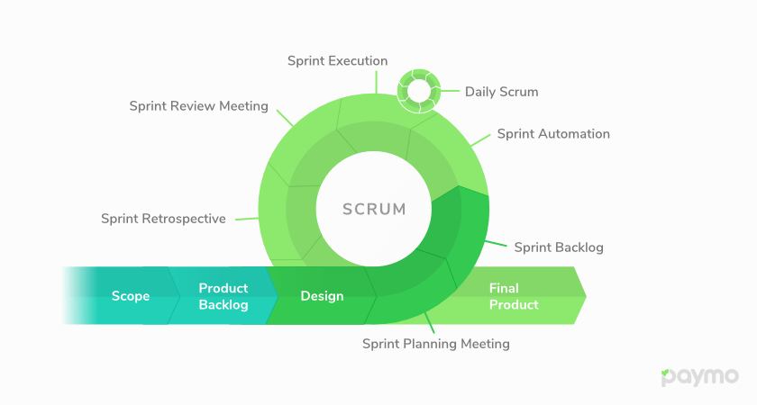
Agile Methodology

Slide 9
Project Working

Slide 10
Github Link:
https://github.com/Ayesha-Azam/OnlineJobPortal

Slide 11
Thank You

